Slide 1

RapHaeL-MY PERSONAL VOICE ASSISTANT
PRESENTED BY- HIMANSHU

Slide 2
INTRODUCTION
Raphael is an intelligent voice assistant developed using Python and web technologies. It can understand voice commands, respond verbally, and perform tasks such as answering queries, opening applications, and managing communication. Integrated with speech recognition and text-to-speech features, Raphael provides a hands-free, interactive user experience.
The idea behind Raphael is to create a smart voice assistant that helps users interact with their computer using voice commands. Instead of typing or clicking, users can simply speak to perform tasks like opening apps, searching for information, or sending messages. This makes using a computer easier, faster, and more user-friendly.

Slide 3

ABOUT RAPHAEL
RapHael is a desktop-based AI voice assistant.
It responds to voice and text input
Performs task like opening applications,
communication feature and
more.
Interactive, sleek UI with real-time animation and response.
Chat interface with history.

Slide 4

TECHNOLOGY STACK
FRONTEND - HTML, CSS, JavaScript, Bootstrap
BACKEND - Python ,Eel
Libraries - pyttsx3, speech_recognition, pyaudio,
pyautogui, hugchat , sqlite3.
Tools: Bootstrap, Bootstrap Icons, Textillate.js,
SiriWave.js ,Vs Code, Git ,GIthub

Slide 5
COMPONENT DISCRIPTIONS
USER INTERFACE
Frontend Javascript
Eel(Python)
1. Provides input field,
mic button, settings,
and chat interface.
2. Siri wave rendering
3. Animated cirlces
1. Handling Buttons
clicks
2. Listening to user
voices
3. Sending/Reciving
messages using Eel
Act as a bridge between Frontend and Backend
Python Backend
OS Functions
1.speech_recognition
2.pyaudio
3.pyttsx3
4.pyautogui
5.hugchat(AI Support)
6.Custom made
functions
1.Opens local apps
2.Using os command as
support for other
functions

Slide 6
Key Functionalities:
1. Listens to the user’s voice input on mic click.
2. Converts speech to text using SpeechRecognition.
3. Analyzes the command using conditions or ChatGPT API.
4. Executes actions like opening apps, fetching responses, or replying vocally.
5. Uses pyttsx3 to speak the response.
6. Sends output text to frontend for display.
7. Maintains session via eel communication loop.

Slide 7
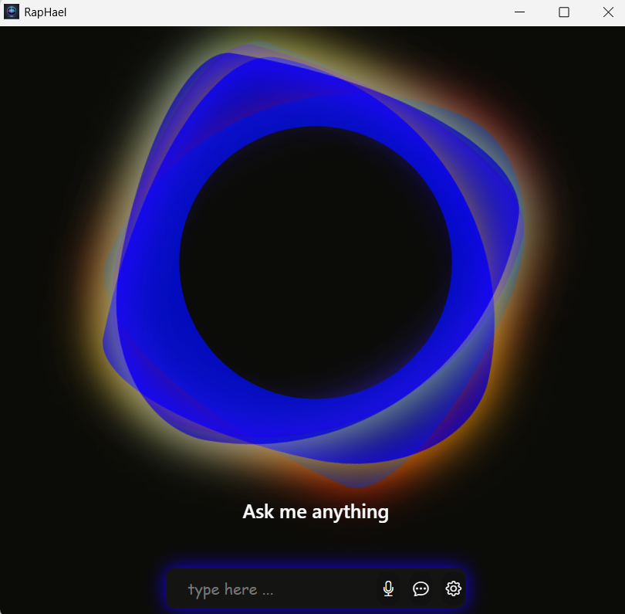
RAPHAEL INTERFACE UI

Slide 8
CODE HIGHLIGHTS
FRONTEND: HTML , CSS ,JAVASCRIPT , BOOTSTRAP
HTML
1. Created the structural layout
of the webpage.
2. Included important
components like chat input
field, control buttons (mic,
send, chat, settings),
Siri wave area.
3. Used semantic tags and
responsive grid with
Bootstrap classes for better
alignment .
CSS
1. Customized design using
gradients, shadows, rounded
shapes, and hover effects.
2. Added animations to enhance
user interaction (e.g., glowing
mic button, animated
Siri wave background).
3. Managed layout spacing and
colors to match a dark
futuristic theme.

Slide 9
Bootstrap
1. Enabled responsive design for
all screen sizes.
2. Used Bootstrap grid system for
aligning elements.
3. Integrated Bootstrap Icons for
intuitive UI controls (like mic,
chat, gear icons).
4. Implemented offcanvas
sidebar for chat history
display.
JavaScript
1. Controlled interactivity like
button clicks and speech
handling.
2. Integrated siriwave.js to
visually display voice
recognition activity.
3. Used jQuery plugins
(textillate.js, lettering.js) for
animated text headings.
4. Connected frontend with
Python backend using Eel.js for
real-time interaction.

Slide 10
BACKEND
Overview:
The backend of the Raphael Voice Assistant handles all the core logic, speech processing, and response generation functionalities. It interacts with both system-level commands and external APIs to process voice input and generate meaningful replies.
Technologies Used:
1. Python: Primary language for logic and processing.
2. Eel: Used to bridge the communication between the Python backend and
HTML/JS frontend.
3. SpeechRecognition: Captures and processes user voice input.
4. PyAudio: Supports real-time voice input from the mic.
5. pyttsx3: Converts text responses into voice output.
6. HugFace (HugChat): for generating AI responses.
7. Custom made Functions for performing task like ->Opening Desktop Application
->Whatsapp automation
->Weburl opening(like youtube,whatsapp facebook etc.)

Slide 11
Connecting Backend with Frontend using Eel
1. Eel is a Python library that allows easy
communication between Python
(backend) and HTML/JavaScript
(frontend).
2. Acts as a bridge between the voice
processing logic and the user interface.
3. HTML, CSS, and JS are loaded in a
browser-like window by Python.
4. JS functions can call Python functions
using eel.expose() and vice versa.
5. Enables seamless data flow: user speaks
→ Python processes → result shown on
UI and spoken back.
Text-to-Speech using pyttsx3
1. pyttsx3 is a Python library used
for converting text to speech.
2. It Converts the assistant's
response into audio so the user
can hear the reply.
3. Integrated in the backend to
respond vocally after processing
commands.

Slide 12
Speech Recognition using speech_recognition & pyaudio
HugChat Integration using Cookie Session
1. Used to capture and convert spoken
commands into text.
2. speech_recognition handles the
transcription of audio input into readable
text.
3. pyaudio is used to access the microphone
and stream audio in real time.
4. Enables voice-controlled interaction with
the assistant.
5. Supports multiple recognition engines
(like Google Web Speech API).
6. Essential for hands-free, seamless voice
input experience.
1. HugChat is integrated to enable natural
language understanding via ChatGPT.
2. Used cookie-based session authentication
to maintain login state securely.
3. Allows sending and receiving messages
programmatically through the Hugging
Face Chat API.
4. Ensures persistent session management
without re-authenticating each time.
5. Enhances conversation continuity and
simplifies backend interaction with the AI
model.

Slide 13
CUSTOM MADE FUNCTIONS
Custom Open Application Functionality
1. Implemented a dynamic openCommand() function to open installed applications
or websites via voice command.
2. Recognizes command by stripping the assistant’s name and the word “open” from
the query.
3. Searches the local SQLite database for:
->sys_command table: If found, launches the application using os.startfile().
->web_command table: If not found in system, tries to open the URL in browser
using webbrowser.open().
4. Falls back to the system command line (os.system) if no matches are found in the
database.
5. Includes robust error handling and uses pyttsx3 to provide voice feedback.
6. Also implemented YouTube search and playback with PlayYoutube() using
pywhatkit.

Slide 14
WhatsApp Automation
1. Developed a powerful feature that allows the assistant to send WhatsApp messages,
make calls, and initiate video calls through voice input.
2. findContact(query): (Function)
->Extracts and cleans the contact name from the voice query using regex.
->Searches the SQLite contact database using partial match queries (LIKE) to retrieve
contact details.
3. whatsApp():(Function)
->Determines the user’s intent (message, call, video call) from the query.
->Constructs a WhatsApp deep link using the contact’s number and message.
->Uses subprocess to open WhatsApp via URL scheme (whatsapp://send).
->Automates interface interaction using pyautogui (keyboard shortcuts and tab
navigation).
->Encodes and sends the typed message or triggers the appropriate call action.

Slide 15
Mobile Automation
1. Implemented a feature to initiate mobile phone calls using the Android Debug Bridge
(ADB).
2. Function: makeCall(name, mobileNo)
->Cleans the mobile number to ensure compatibility with dial command.
->Uses adb command-line tool to trigger the phone's dialer remotely.
->Executes the shell command:
Shell command:
adb -s <device_ip>:5555 shell am start -a android.intent.action.DIAL -d tel:<number>
3. Enables remote calling on a connected Android device over Wi-Fi (TCP/IP).
4. Assistant provides voice feedback like “Calling [name]” using pyttsx3.
5. This feature demonstrates real-world hardware interaction and opens the door to
future mobile automation like messaging or app launching.

Slide 16
Challenges Faced
1. 🔧 Backend & Frontend Integration
Ensuring smooth communication between Python backend and HTML/JS frontend
using the Eel library.
2. 🗣️ Speech Recognition Accuracy
Difficulty in recognizing accents, background noise interference, and handling
misinterpretations of spoken commands.
3. 🔒 Handling API Sessions
Managing HugChat authentication using cookies-based session handling and
keeping it secure.
4. 📦 Application Launch Handling
Executing custom app or web launches dynamically via database lookup or fallback
system command.
5. 📱 WhatsApp Automation
Managing WhatsApp Web automation using PyAutoGUI was sensitive to screen
resolution, delays, and UI changes.
6. 📞 Mobile Integration with ADB
Challenges in maintaining ADB connection over IP and permission issues on the
mobile device.
7. 🧠 Command Extraction & Processing
Parsing natural language queries to accurately extract actionable commands and
intent.

Slide 17
Future Enhancements
1. 🚀 Expand Command Dataset
Add support for more natural language commands and improve the assistant’s
understanding of varied phrases.
2. 🌐 Multilingual Support
Add the ability to understand and respond in multiple regional and international
languages.
3. 🎤 Wake Word Activation
Implement hotword detection (e.g., “Hey Raphael”) to activate the assistant without
clicking the mic.
4. 📱 Mobile App Version
Develop a cross-platform mobile app to bring Raphael's features to smartphones.
5. 🧠 AI Model Integration
Incorporate GPT-like NLP models directly for smarter conversations without external
API dependence.
6. 🔐 Voice-Based Authentication
Integrate voice biometrics to secure access to sensitive features.

Slide 18
CONCLUSION
1. ✅ Smart and Interactive Assistant
"Raphael" acts as a personalized voice assistant that can handle tasks like opening
applications, making WhatsApp calls, sending messages, playing YouTube videos, and
more—using simple voice commands.
2. 💡 User-Friendly Design
Built with a clean Bootstrap-based interface and smooth Python backend, the assistant
ensures ease of use for all users.
3. 🔒 Secure and Modular Architecture
With SQLite databases, speech libraries, and session-based HugChat integration, the
backend is designed for both flexibility and safety.
4. 🚀 Scalable and Extendable
The architecture allows for easy addition of new features and modules like smart home
integration or real-time information retrieval.
5. 🎯 Learning Experience
This project provided hands-on experience in frontend/backend integration, API usage,
voice processing, and automation with real-world applications.

Slide 19



01
Add your title
THANK YOU

